Slide 1
Slava
viacheslav.filonenko@dit.ie

Slide 2
Introduction
Adapted from
Computer: A history of the information machine
by Martin Campbell-Kelly

Slide 3
Internet
End of 1990 there were just 313,000 computers on the Internet;
End of 1995 – almost 10 million,
End of 2000 - exceeded 100 million.
Today there are more than 8.7 billion devices connected to the Internet.

Slide 4
ARPANET
Became operational in 1963
By networking ARPA’s computer systems together, the users of each computer would be able to use the facilities of any other computer on the network; specialized facilities would thus be available to all, and it would be possible to spread the computing load over many geographically separated sites.
There were several other groups interested in computer networking in the United States, England, and France.

Slide 5
Technical Problems
How to physically connect all the time-sharing systems together.
How to make economic use of the expensive high-speed communications lines connecting computers.
How to link together all the computer systems, which came from different manufacturers and used many varieties of operating software.

Slide 6
Solution to 1 & 2
“store-and-forward packet switching”
Similar to an older telegraph technology.
Single “backbone” communications line that connected the computers together, with other connections being added as the need arose.
So that a single user did not monopolize a line, data would be shuttled around the network in packets.
Enabled sharing of communication lines.

Slide 7
Solution to 3
Interface Message Processor
First generation of Gateways, now called routers.
Handles all the data communications traffic.

Slide 8
Electronic Mail (email)
Never been an important motivation for Arpanet.
Only in July 1971 an experimental mail system for Arpanet was developed by two programmers.
Soon exceeded all other forms of network traffic on Arpanet
By 1975 there were over a thousand registered e-mail users.
Major driving force for the first non-ARPA networks. (e.g. USENET)

Slide 9
Connecting networks
Not all networks were based on the technology developed in Arpanet.
Manufacturers were hoping to keep their customers locked into proprietary networks.
However the real benefits of networking came through internetworking—in which the separate networks were connected and literally every computer user could talk to every other.
ARPA devised Transmission Control Protocol/Internet Protocol, or TCP/IP.
By the late 1980s most professional computer users in the United States had access to the Internet, and the number of computers on the Internet began an explosive growth.

Slide 10
File sharing
Once this much broader community of users started to use the Internet, people began to exchange not just e-mails but whole documents.
Numerous parallel developments were under way to create finding aids for information on the Internet.
“archie” system created a directory of all available files
Wide Area Information Service (WAIS) enabled users to specify documents by using keywords
“gopher ” catalog of catalogs.

Slide 11
WWW
Inventors of hypertext had envisaged a system that would enable one to informally skip from document to document. Links would be stored in the documents themselves.
The World Wide Web was invented by Tim Berners-Lee.
Individuals needed web “browsers” to read web pages on their personal computers and workstations, while organizations needed to set up web servers filled with interesting and relevant information to make the process worthwhile.
Berners-Lee moved to MIT where he would head the World Wide Web Consortium (W3C), a nonprofit organization to encourage the creation of web standards through consensus.

Slide 12
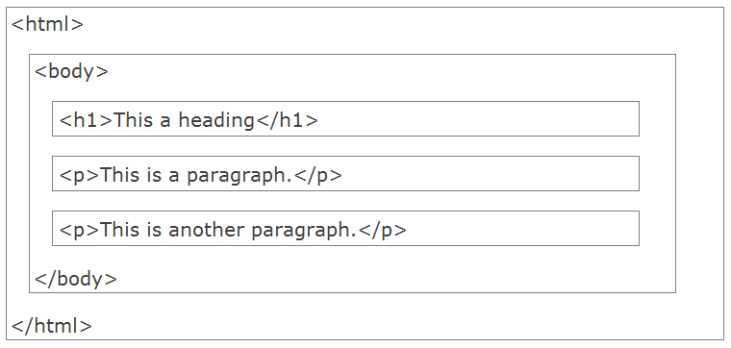
HTML Page Structure

Slide 13
Early Web Browsers
Mosaic was developed by by a twenty-two-year-old computer science undergraduate, Marc Andreessen.
He later joined Netscape.
During 1995-1997 Microsoft and Netscape battled for browser supremacy.
Because Internet Explorer was bundled at no extra cost with the new Windows 98 operating system, it became the most commonly used browser on PCs. There was also a free version for Macintosh.

Slide 14
Domain Names
In the mid-1980s the Internet community adopted the domain-name system devised by Paul Mockapetris.
The process started with the creation of six top-level domains: com for commercial organizations, edu for educational institutions, net for network operators, mil for military, gov for government, and org for all other organizations.
Outside the United States, countries were allocated a two-letter suffix—uk for the United Kingdom, ie for Ireland, and so on.

Slide 15
Internet Timeline
80s – mainly used by enthusiasts.
90s – e-business emerges.
00s – social media, used generated content
10s – mobile, desktop and browser application boundaries are vanishing?

Slide 16
What is JavaScript?
JavaScript is a dynamic computer programming language.
Dynamic programming language is a class of high-level programming languages which, at runtime, execute many common programming behaviors that static programming languages perform during compilation.
Dynamic languages can be (but not always) frequently referred to as "scripting languages“.
Executed client-side, by the user's web browser.
As opposed to server-side (on the web server).
Like many dynamic languages JavaScript is dynamically typed.
Duck Typing. It means that rather than checking a tag to see whether a value has the correct general type to be used in some way, the runtime system merely checks that it supports all of the operations performed on it.
JavaScript is untyped.
JavaScript is not part of the Java platform.
They were created by completely different people and are not directly related.

Slide 17
Use in web pages
Loading new page content or submitting data to the server via AJAX without reloading the page (for example, a social network might allow the user to post status updates without leaving the page).
Animation of page elements, fading them in and out, resizing them, moving them, etc.
Interactive content, for example games, and playing audio and video.
Validating input values of a web form to make sure that they are acceptable before being submitted to the server.
Transmitting information about the user's reading habits and browsing activities to various websites. Web pages frequently do this for web analytics, ad tracking, personalization or other purposes.

Slide 18
Writing to The Document Output
The example below writes <h1> & <p> element directly into the HTML document output:
<!DOCTYPE html>
<html>
<body>
<p>Above</p>
<script>
document.write("<h1>This is a heading</h1>");
document.write("<p>This is a paragraph.</p>");
</script>
<p>Below</p>
</body>
</html>

